Slide 1
REST & LiveStreaming
Alexey Ogarkov

Slide 2
REST
Stateless
Cacheable
Scalable
Resource based

Slide 3
Designing API
It should use web standards where they make sense
It should be friendly to the developer
It should be simple

Slide 4
Resources
GET /tickets - Retrieves a list of tickets
GET /tickets/12 - Retrieves a specific ticket
POST /tickets - Creates a new ticket
PUT /tickets/12 - Updates ticket #12
PATCH /tickets/12 - Partially updates ticket #12
DELETE /tickets/12 - Deletes ticket #12

Slide 5
Relations
GET /tickets/12/messages - Retrieves list of messages for ticket #12
GET /tickets/12/messages/5 - Retrieves message #5 for ticket #12
POST /tickets/12/messages - Creates a new message in ticket #12
PUT /tickets/12/messages/5 - Updates message #5 for ticket #12
PATCH /tickets/12/messages/5 - Partially updates message #5 for ticket #12
DELETE /tickets/12/messages/5 - Deletes message #5 for ticket #12

Slide 6
CRUD? That`s it?
Make your action look like field (e.g. /marked and use PUT to execute it and set it virtually to true)
It could look like subresource PUT /shows/:id/like
Search …. oh… use just /search and forget about it☺
If search is related to Resource it could look like ‘GET /tickets?q=return&state=open&sort=-priority,created_at’
Create aliases for common queries ‘GET /tickets/recently_closed’

Slide 7
Documentation
Show demo how it could be solved

Slide 8
In addition
Produce data with different content types
GZIP your responses
Client caching (Etag and Last-Modified)
Use HTTP Statuses
Return errors like { "code" : 1234, "message" : "Something bad happened :(", "description" : "More details about the error here" }

Slide 9
Http Statuses
200 OK - Response to a successful GET, PUT, PATCH or DELETE. Can also be used for a POST that doesn't result in a creation.
201 Created - Response to a POST that results in a creation. Should be combined with a Location header pointing to the location of the new resource
204 No Content - Response to a successful request that won't be returning a body (like a DELETE request)
304 Not Modified - Used when HTTP caching headers are in play
400 Bad Request - The request is malformed, such as if the body does not parse
401 Unauthorized - When no or invalid authentication details are provided. Also useful to trigger an auth popup if the API is used from a browser
403 Forbidden - When authentication succeeded but authenticated user doesn't have access to the resource
404 Not Found - When a non-existent resource is requested
405 Method Not Allowed - When an HTTP method is being requested that isn't allowed for the authenticated user
410 Gone - Indicates that the resource at this end point is no longer available. Useful as a blanket response for old API versions
415 Unsupported Media Type - If incorrect content type was provided as part of the request
422 Unprocessable Entity - Used for validation errors
429 Too Many Requests - When a request is rejected due to rate limiting

Slide 10
Antipatterns
Tunneling everything through GET
Tunneling everything through POST
GET /api?method=addCustomer&name=Test
GET /api?method=deleteCustomer&id=42
GET /api?method=getCustomerName&id=42
GET /api?method=findCustomers&name=Test*

Slide 11
Java
JAXB
JAX-RS implementations (Resteasy & Jersey are good)
It`s also easy to build REST API with Spring
Swagger

Slide 12
Live streaming
Websockets
Long-polling
Server sent events

Slide 13
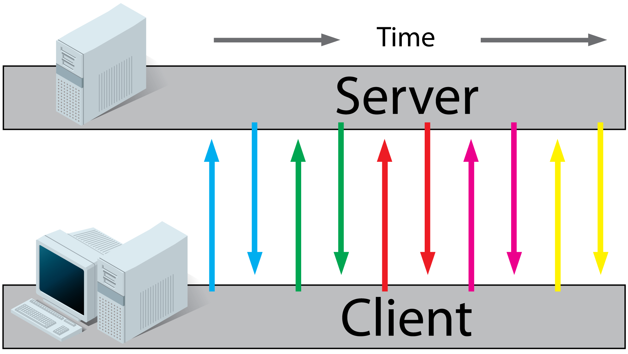
Simple AJAX polling

Slide 14
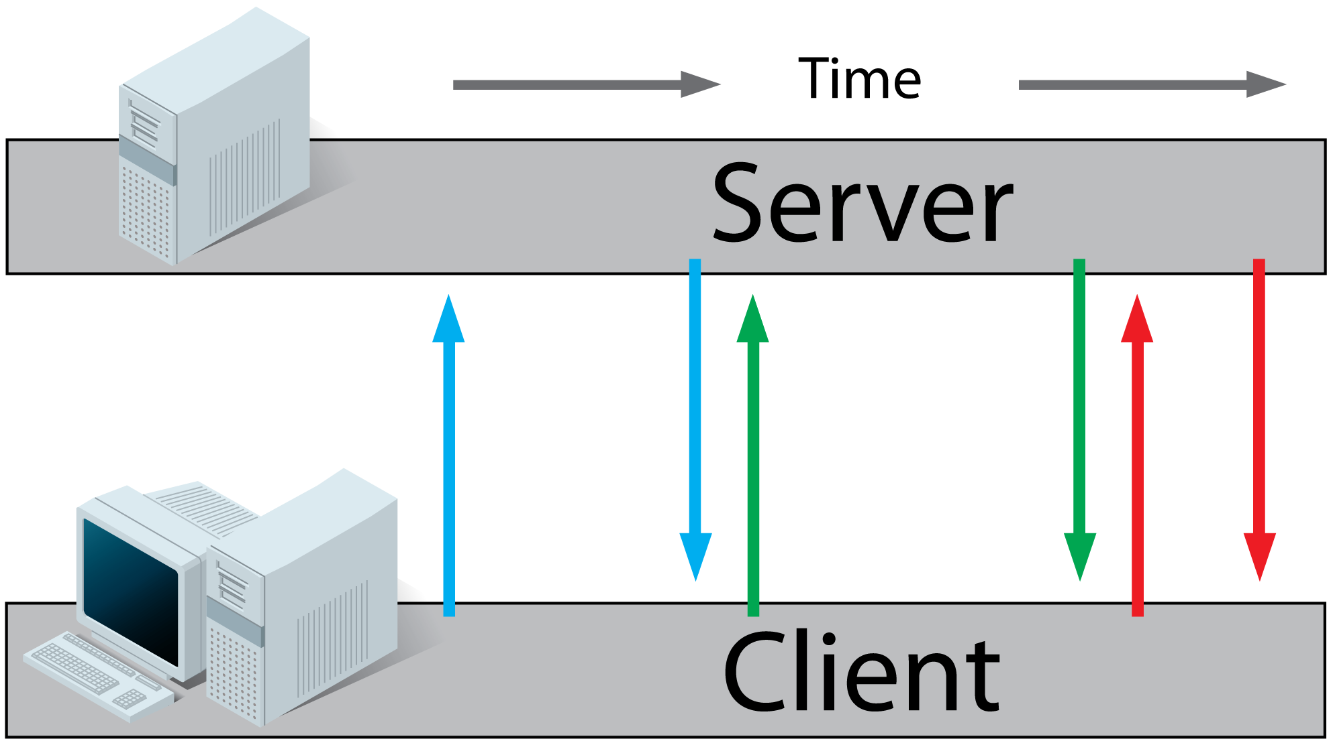
Long polling

Slide 15
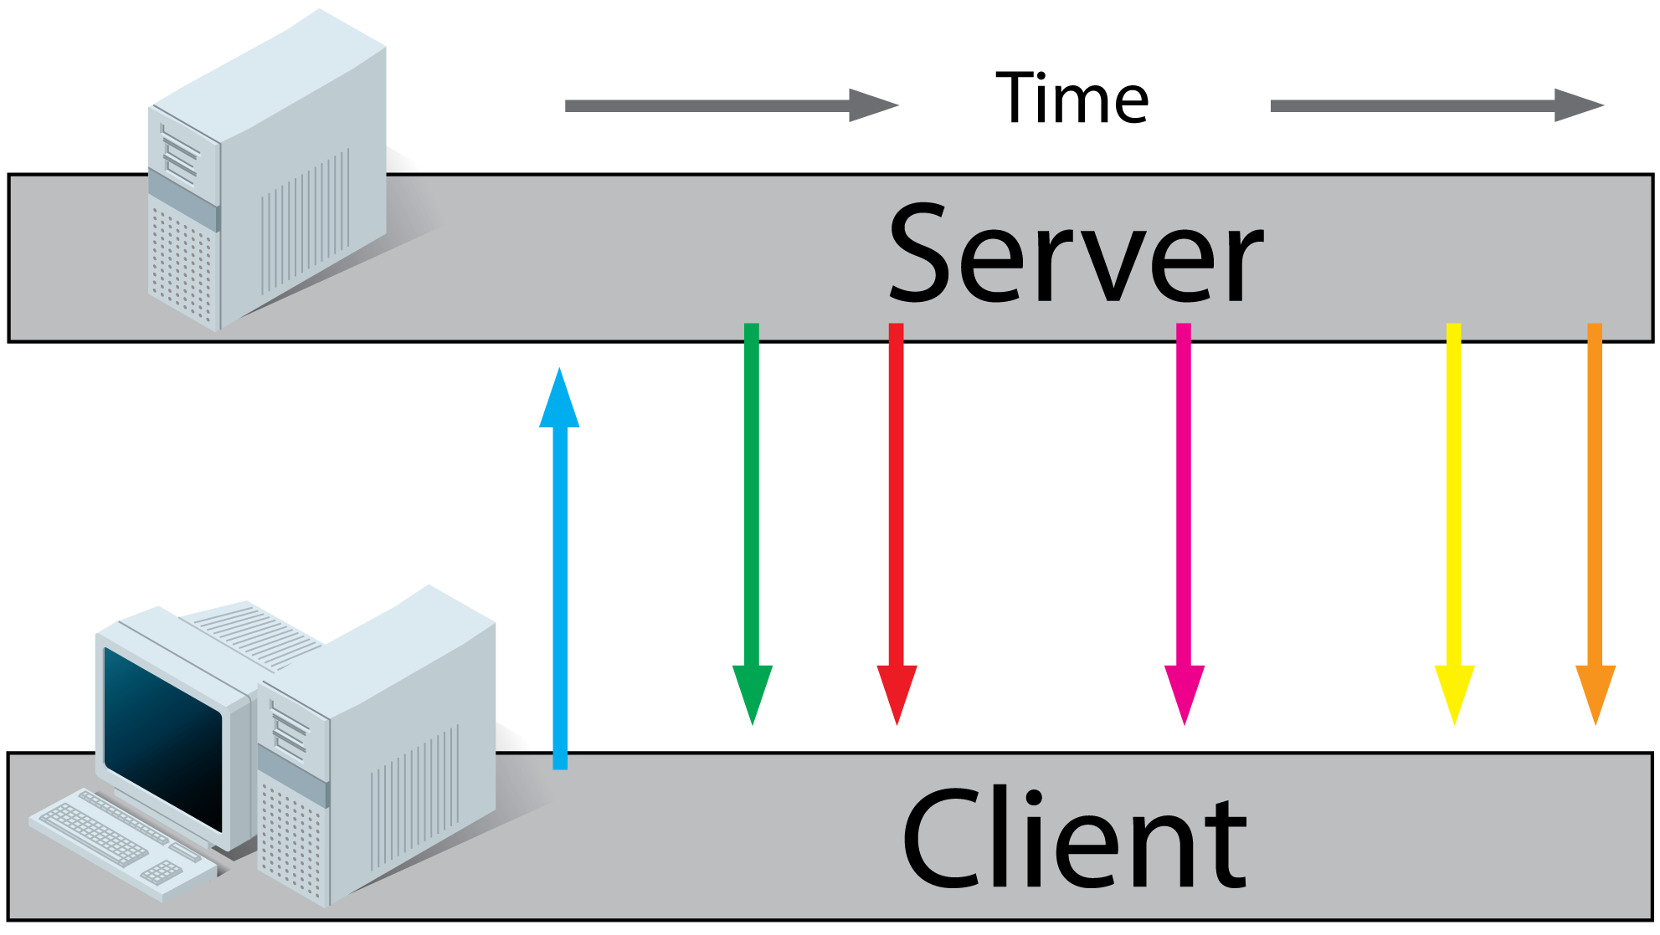
Forever iframe

Slide 16
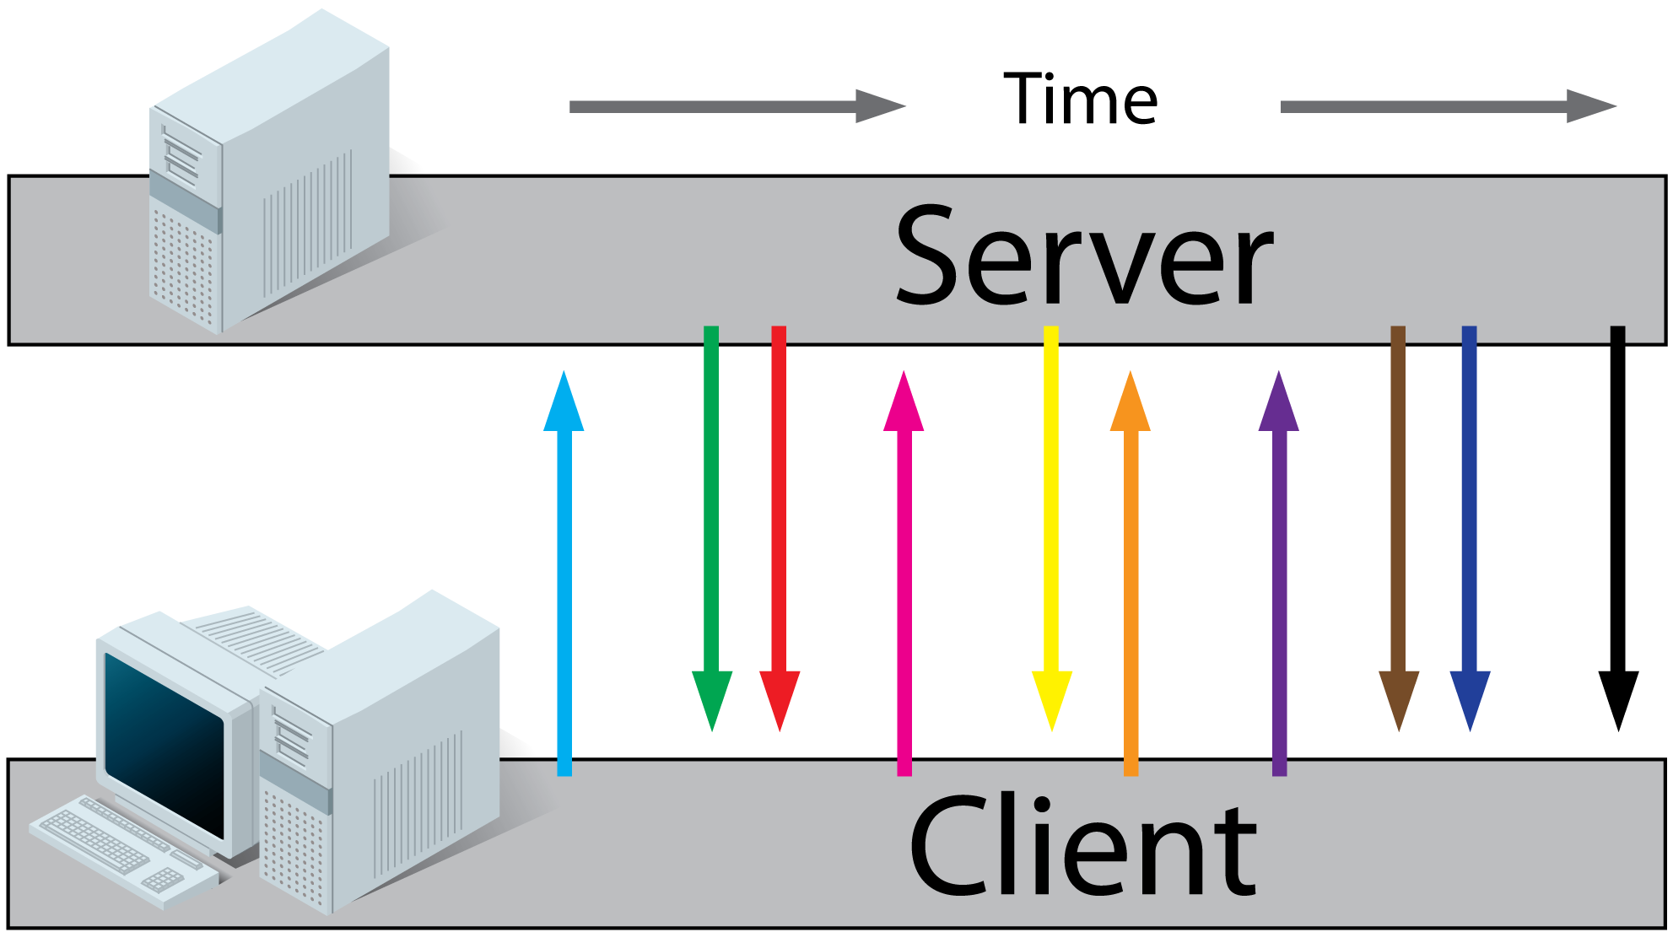
Websockets

Slide 17
Atmosphere
Combined with JAX-RS annotations
Comet and WebSocket jQuery plugin
Browser based fallback
Clustering support
Spring, GWT, Scala, JSF integrations

Slide 18
Terracota Messaging
JavaScript API
Fallback for modern -> old browsers (websockets, comet, long-poll)

